Slide 1
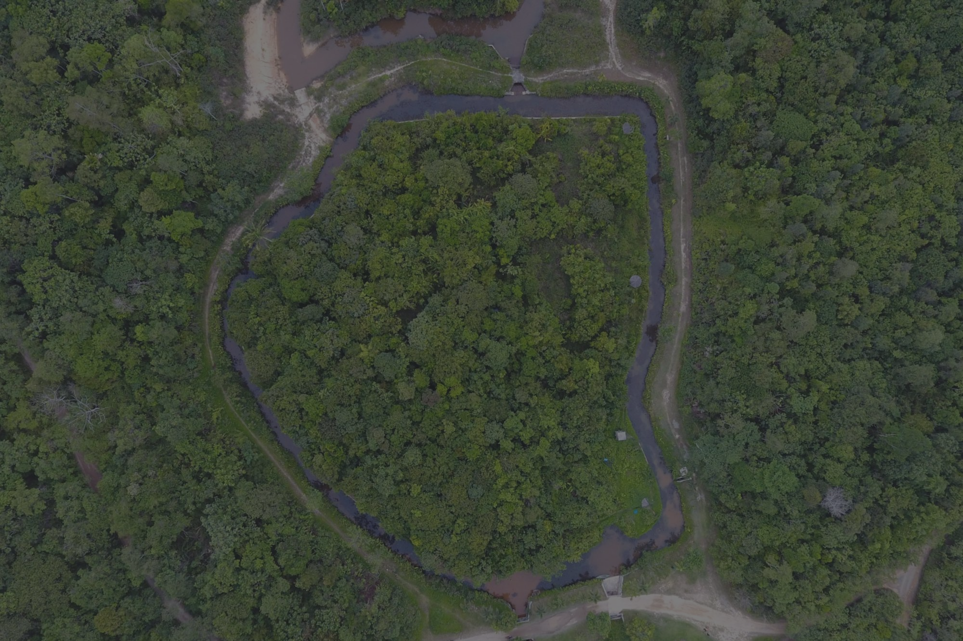
ROUTING ALGORITHM FOR SENSOR NETWORKS AND IOT
SEMESTER -7 PROJECT

Slide 2

OUR TEAM HAS:
VEDANSHI VERMA
SPARSH RATHI
SATHWIKA
ARYAN RAY

Slide 3

PROBLEM STATEMENT
You have a set of nodes (computing devices). You need to select a certain set of gateway nodes from among the set of nodes that will be responsible for collecting data from other nodes and sending them over the network. The idea is to find the right amount of gateway nodes to be selected (number, location in a cluster, health of the node - in terms of connectivity and energy, etc.) such that the set of nodes in a cluster remain in operation for a longer period of time when compared to a situation when there is only one gateway node in the cluster. We will not be working with actual nodes and networks but will simulate the nodes and network on Python.

Slide 4

TL ; DR?
Let me help you.
Real Life Analogy

Slide 5
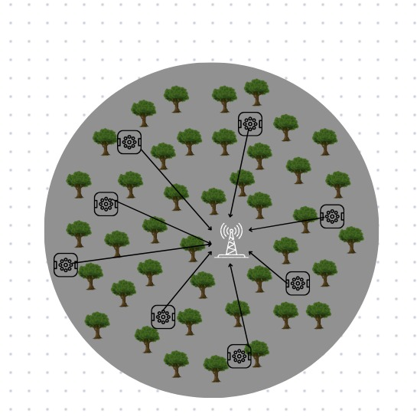
FOREST,
with RANDOM deployment of nodes.
Sensor Variable: Temperature (let)

Slide 6
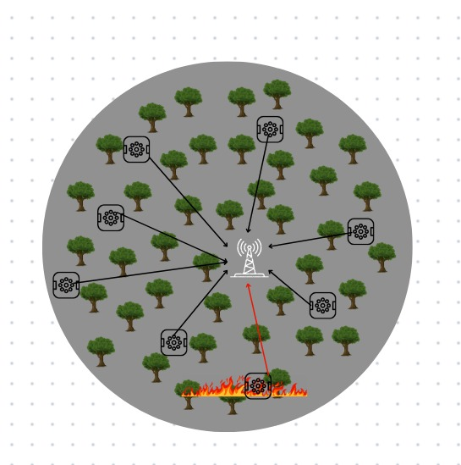
FOREST, with
RANDOM deployment
of nodes.
FIRE in forest detected by sensors.

Slide 7
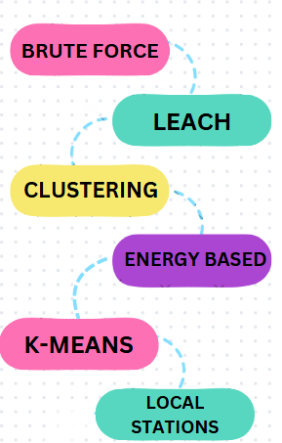
Brainstorming
To tackle the problem, we explored various approaches to balance energy efficiency, connectivity, and network longevity. Initial ideas were tested through trial-and-error, helping us refine our methods and identify key challenges like node placement and dynamic health management.

Slide 8



EVALUATION FACTORS
THE FACTORS ON WHICH WE EVALUATED OUR METHODS ARE:
NETWORK LIFETIME
ENERGY EFFICIENCY
NUMBER OF HOPS
until a significant portion of the nodes deplete their energy or the network becomes non-functional.
Ensures that nodes consume energy optimally, prolonging the overall network lifetime.
Determines the distance (in terms of intermediate nodes) data needs to travel to reach the gateway

Slide 9
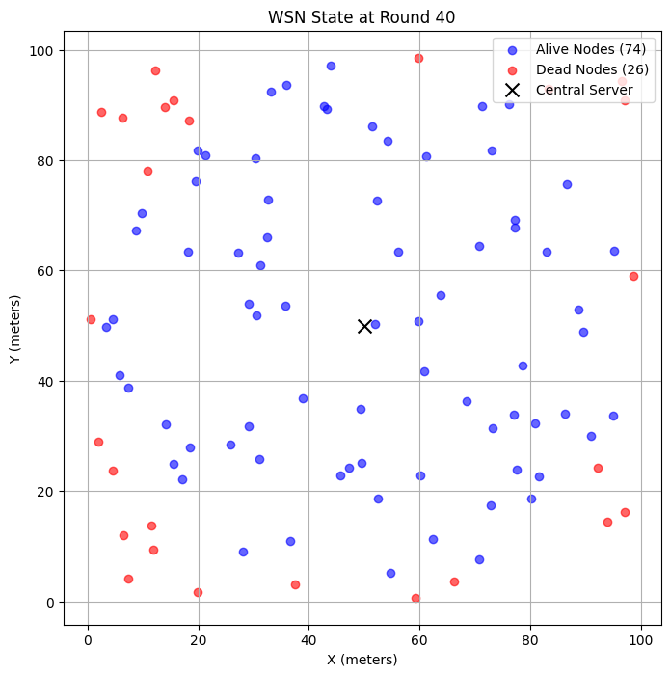


APPROACH 1
Nodes deployed randomly in a 2D area.
BRUTE FORCE
Each node has an initial energy and transmits data directly to a base station.
Energy dissipation based on distance from the base station, with node failure based on energy.
Realistic simulation of energy depletion
Excludes inter-node communication and dynamic environments.
Provides visual insights

Slide 10
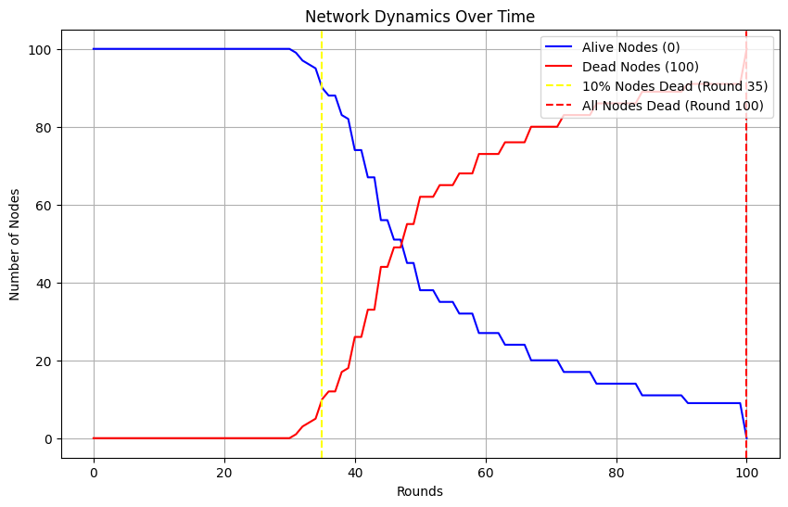

Slide 11
APPROACH 2
LEACH protocol
Instead of every sensor constantly sending alerts to a central station (which drains their energy), some sensors act as leaders, gathering data from nearby sensors and forwarding it.
ANALOGY:
Suppose, all students submit their assignments to a CRs of their batch, and they transfer it to their HOD.

Slide 12
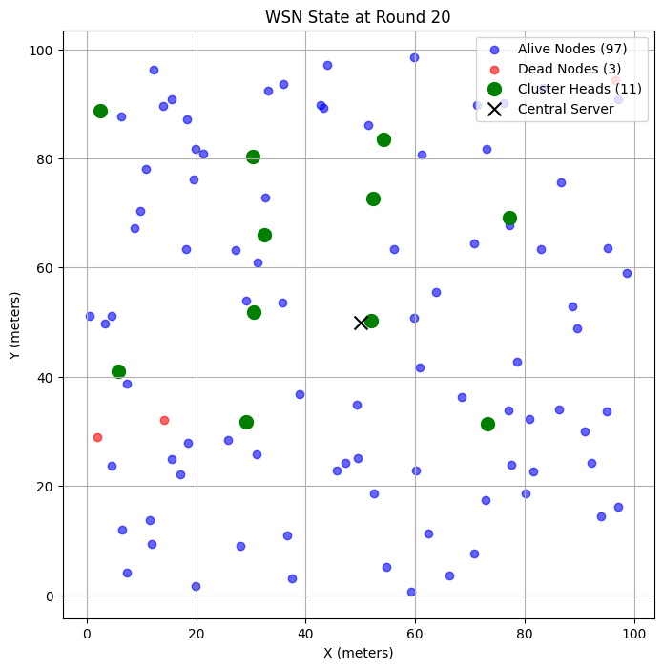
APPROACH 2
Nodes self-organize into clusters and select Cluster Heads (CHs)
LEACH protocol
Each node has a fixed probability (p) of becoming a CH.
Fair load distribution via rotating CHs extends network lifetime and tracks key performance metrics.
Improves energy efficiency through clustering and reduced long-range communication.
Lacks accuracy in energy depletion by ignoring idle or sleep states in real-world WSNs.
Provides visual insights

Slide 13
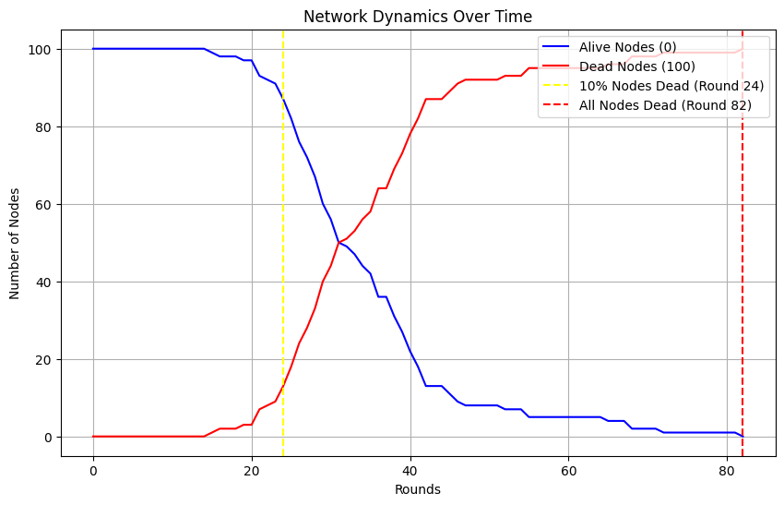
(NUMBER OF ROUNDS & NETWORK LIFETIME DECREASED)

Slide 14
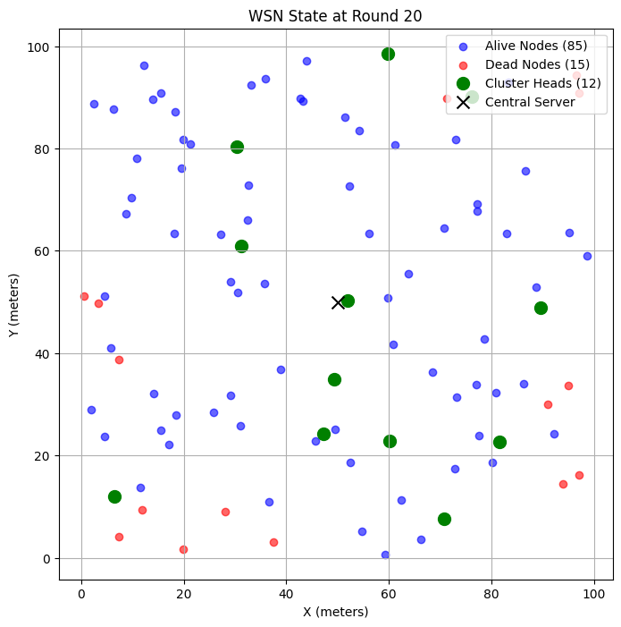
APPROACH 3
Nodes transmit data to a central server via cluster heads (CHs) to optimize energy consumption.
Clustering Approach
Energy optimization through clustering reduces direct communication, with energy dissipation based on distance.
Boosts energy efficiency and network lifetime.
Ignores interference, retransmissions, and idle power.
Random CH election ensures fair resource use.
Lack load balancing and optimal CH placement.

Slide 15
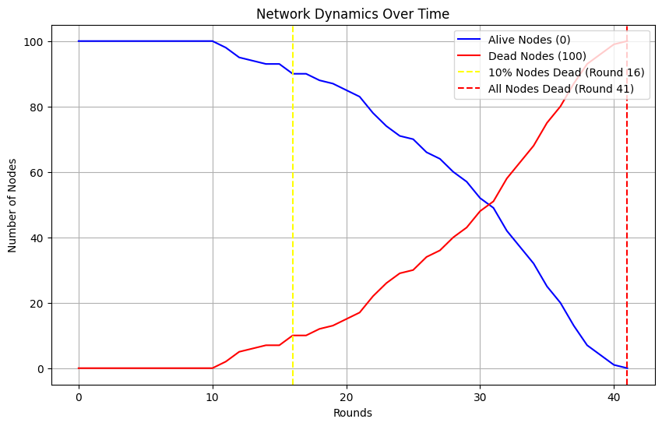
(NUMBER OF ROUNDS AND NETWORK LIFETIME SIGNIFICANTLY DECREASED)

Slide 16
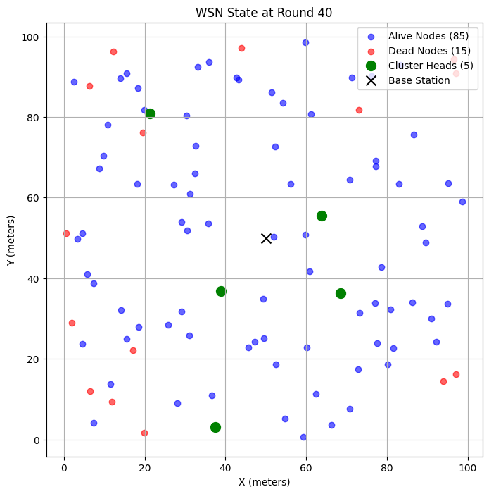
APPROACH 4
Using K-means clustering for energy-efficient communication.
K-means clustering
K-means clustering reduces communication overhead and extends network lifetime.
Dynamic CH selection optimizes performance based on energy levels, with a realistic multi-hop routing and distance-based energy dissipation model.
optimizes energy by minimizing long-range transmissions.
Static thresholds may not suit all network sizes.
K-means clustering assumes a fixed k, limiting optimal cluster placement.
Scalable and customizable.

Slide 17
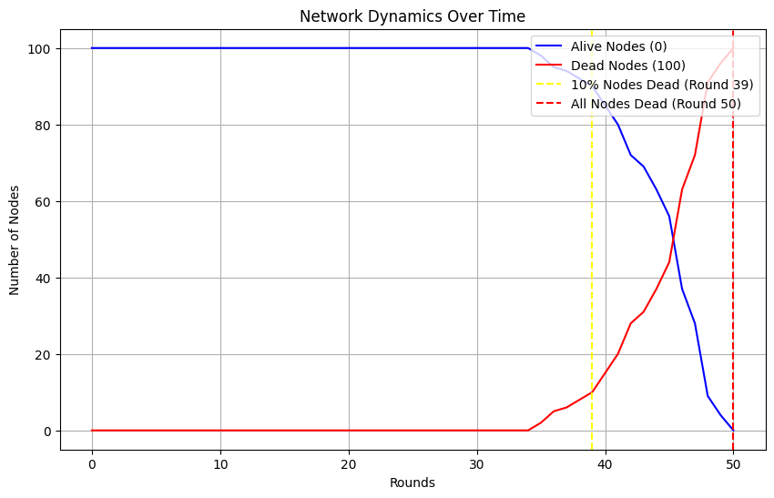
(NUMBER OF ROUNDS SIGNIFICNTLY LESS)

Slide 18
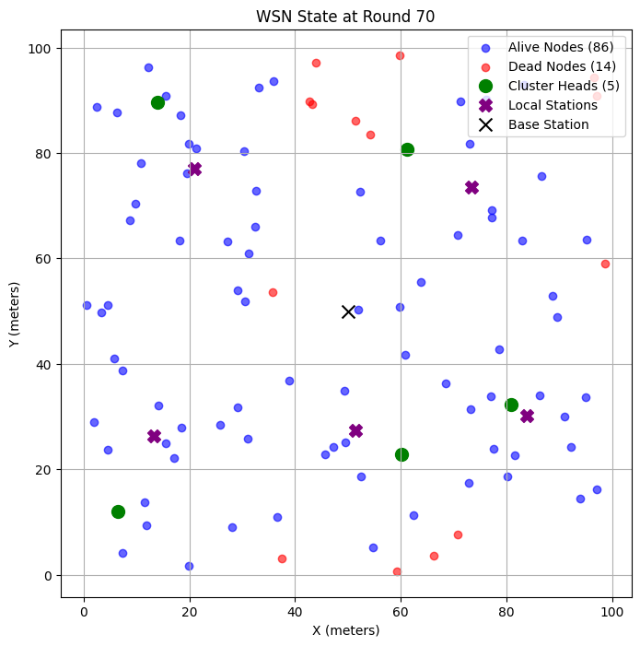
Local Stations for intermediate data aggregation. Nodes are clustered using K-means, and cluster heads (CHs) transmit data to local stations (placed at cluster centers) before relaying it to the base station.
APPROACH 5
Local Stations
K-means clustering efficiently groups nodes for energy-saving, with distance-based energy dissipation modeling realistic multi-hop communication.
Multi Hop enhances energy efficiency and scalability for large networks.
Managing local stations adds computation and complexity.
Human intervention for dedicated node location is not realistically possible.
Local stations reduce CH burden by enabling intermediate data transfer.

Slide 19
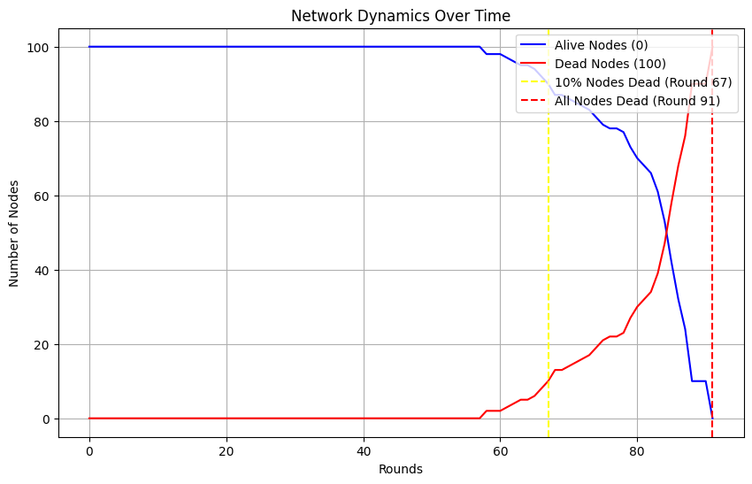

Slide 20
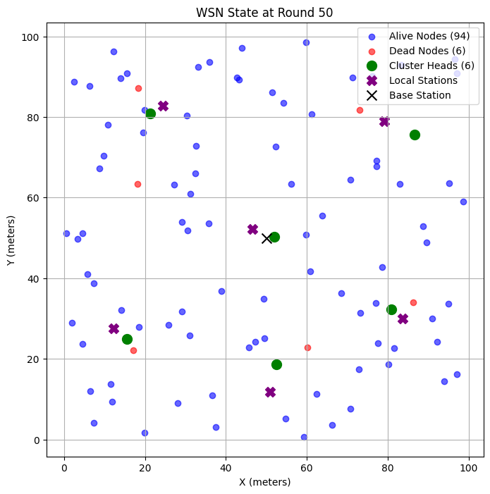
APPROACH 6
Local Stations for intermediate data aggregation. Nodes are clustered using K-means, and cluster heads (CHs) transmit data to local stations (placed near cluster centers) before relaying it to the base station.
Modified
Local Stations
K-means clustering efficiently groups nodes for energy-saving, with distance-based energy dissipation modeling realistic multi-hop communication.
Multi Hop enhances energy efficiency and scalability for large networks.
Managing local stations adds computation and complexity.
Human intervention for dedicated node location is not realistically possible.
Local stations reduce CH burden by enabling intermediate data transfer.

Slide 21
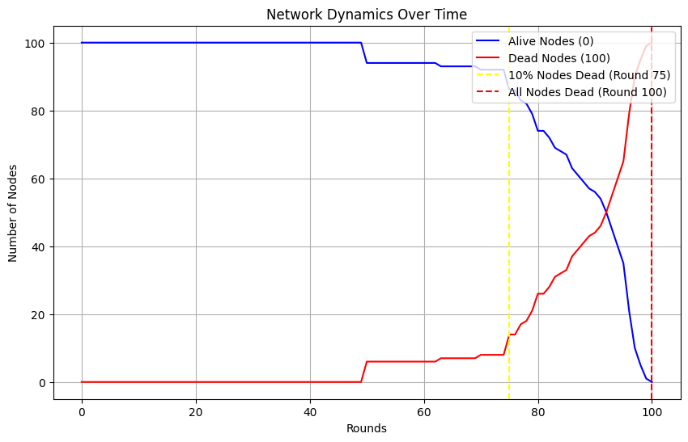

Slide 22

LET’S SEE THE
PERFORMANCE COMPARISON METRICS.
(IT’S ALL IN THE NUMBERS RIGHT?)

Slide 23
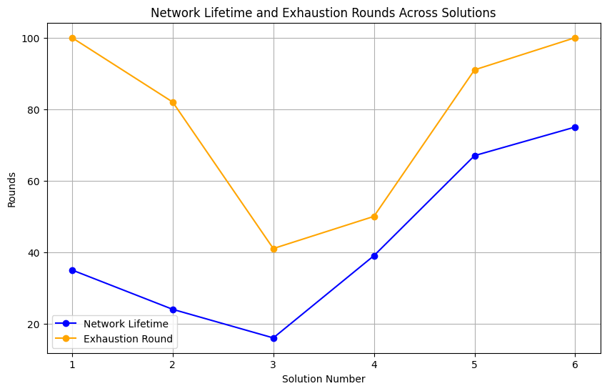

Slide 24

Results & Outcomes
Through the evaluation, Solution with Local Stations + Dynamic CH emerged as the most effective, demonstrating optimal energy efficiency and network longevity.
While Solution 4, with just K means clustering showed promise in terms of network lifetime, it fell short in exhaustion rounds, indicating higher energy depletion rates.
Initial Solutions 1 and 2, despite their simplicity, lack scalability due to poor energy distribution and shorter operational periods.

Slide 25
FUTURE SCOPES
Scaling solutions to accommodate larger and more complex networks, ensuring robustness and efficiency.
1
Enhancing algorithms with adaptive mechanisms that adjust based on network conditions for better optimization.
2
3
Leveraging machine learning techniques to predict optimal cluster head selection and manage network topology.
4
With the implementation of security measures, the network can be safeguarded against potential attacks.

Slide 26
IMPORTANCE OF EFFICIENT GATEWAY SELECTION
It ensures that data transmission is maximized, and the network's lifespan is extended. Network resources can be used more effectively, leading to better performance and reduced energy consumption.
CONCLUSION
DYNAMIC AND ADAPTIVE METHODS
Employing dynamic and adaptive methods helps maintain network robustness by allowing for quick adjustments in response to changing network conditions.
STRENGTH OF COMBINED APPROACHES
Using combined approaches, such as integrating adaptive clustering and dynamic routing algorithms, greatly enhances communication and network efficiency. The synergy of these methods contributes to a more reliable and robust network.

Slide 27

GOT QUESTIONS?
We’re happy to answer!

Slide 28



Thank you so much, Professors!

